Slide 1
Vagus nerve stimulator for clinically induceD asystole
Team members
Sanika Phatak
Kushal Sreenuprasad
Teresa George

Slide 2
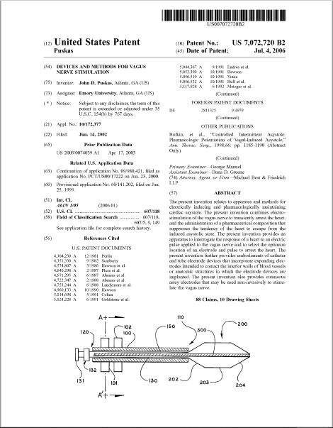
The Device
Patent No.: US 7,072,720 B2 Puskas (45)
Date of Patent: July. 4, 2006
The device helps to achieve Controlled Intermittent Asystole(CIA) of the heart by means of vagus nerve stimulation.

Slide 3
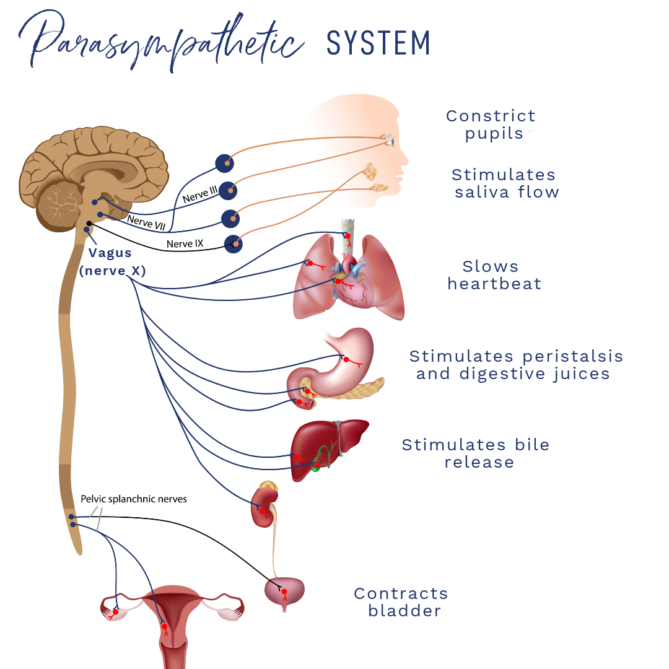
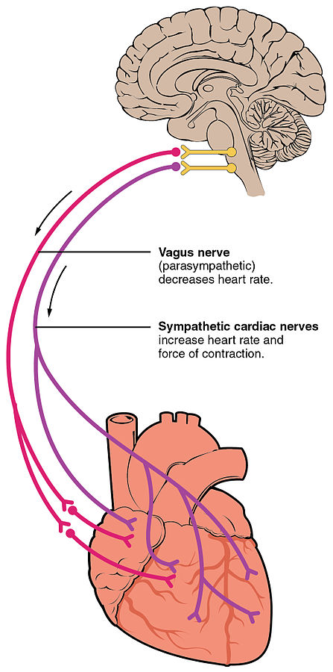
THE vagus nerve
Left vagus nerve: Innervates the AV node and its stimulation causes AV blocks.
Right vagus nerve: Innervates the SA node and its stimulation causes bradyarrhythmias.
Notes:
The vagus nerve is the tenth cranial nerve or CN X It is the longest nerve of the autonomic nervous system.
It interfaces with the parasympathetic control of the heart, lungs, and digestive tract.
The lowering of the heart rate is mediated by the stimulation of the vagus nerve.

Slide 4
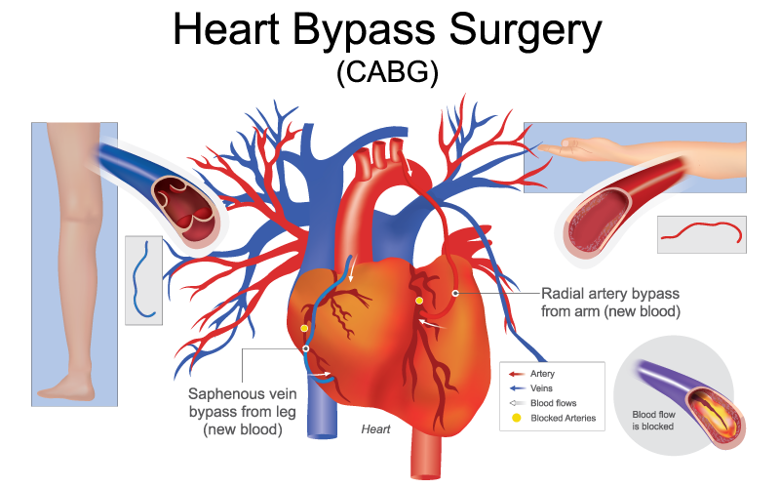
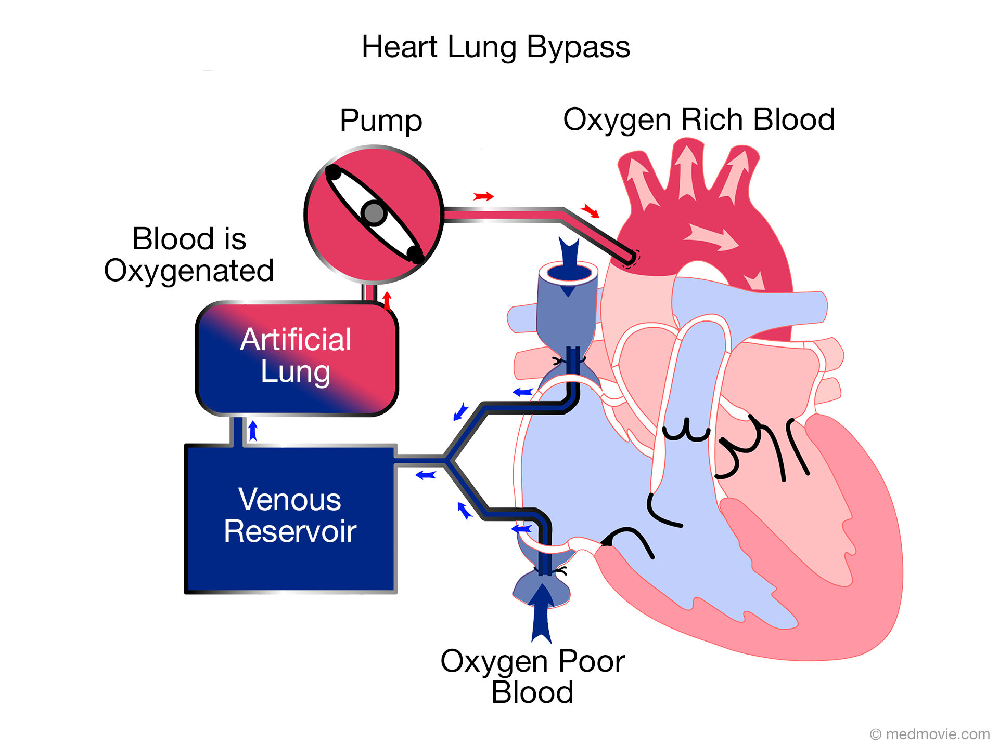
Coronary artery bypass GRAFT surgery (CABG)
Cardiopulmonary bypass(CBP) machine used to stop the heart.
Notes:
Coronary artery bypass grafting (CABG) is a procedure to improve the blood flow to the heart following a coronary artery blockage.
The heart is stopped during the procedure using a Heart lung machine.

Slide 5
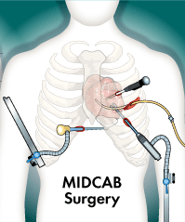
Minimally invasive direct coronary artery bypass surgery (MIDCABG)
Advantages of MIDCABG over CABG:
Less invasive procedure
Easier to perform.
Quicker recovery period.
Heart rate brought back to normal quicker due to use to vagus nerve stimulator over CPB.
Notes:
MIDCAB is performed through the creation of a tiny, two-and-a-half inch opening between two ribs in the left side of the chest.

Slide 6
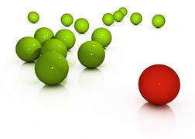

Device used in MIDCABG
CABG: Complete cadioplaegia using CPB
Difference in Asystole occurrence
CABG vs MIDCABG
MIDCABG: Partial cardioplaegia using Vagus nerve stimulation
SIMILARITY?
Pharmacological/chemical suppression is necessary!

Slide 7
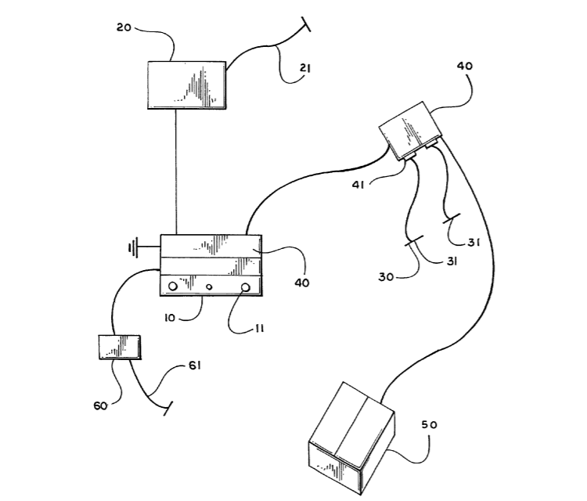
Complete system
Logic circuitry
Interrogator
Cardiac monitor
Cardiac pacemaker
Pulse generator

Slide 8
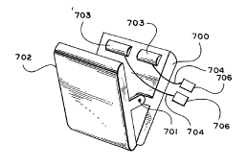
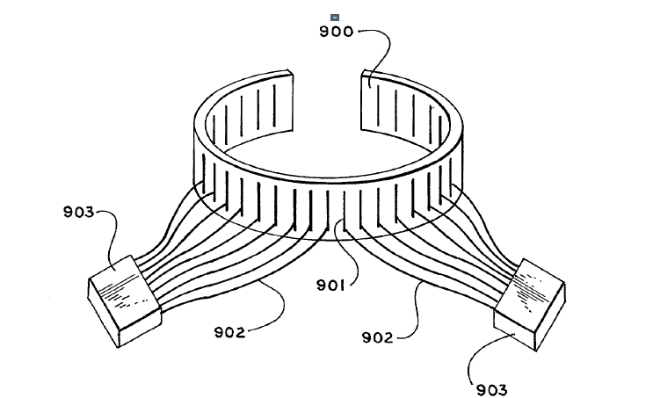
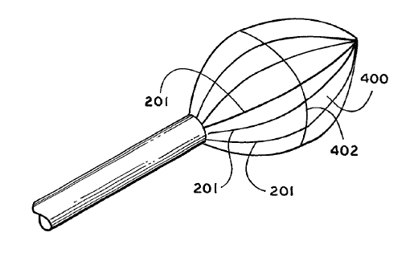
Electrodes
Clipping electrode
Cutaneous electrodes
Balloon electrodes

Slide 9

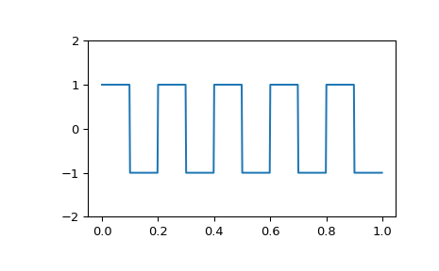
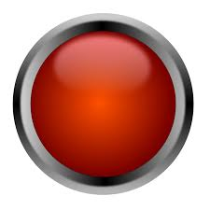
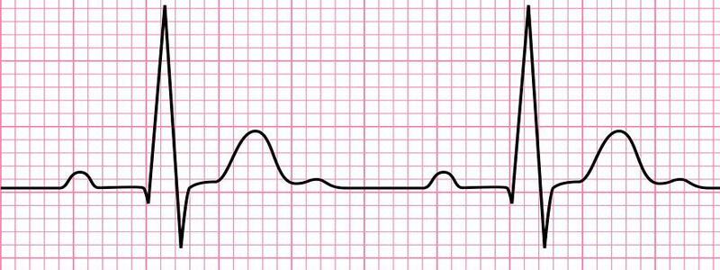
2002 2006 - Interrogator
Electrode A
LOGIC
Electrode B
Electrode C
DECISION
Electrode D

Slide 10
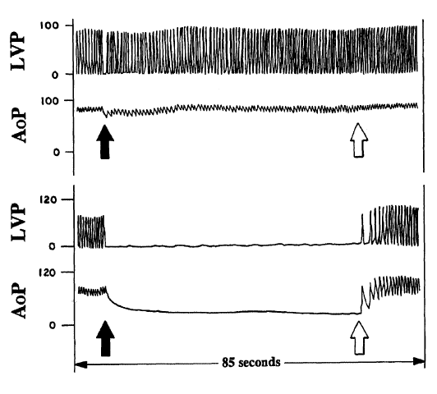
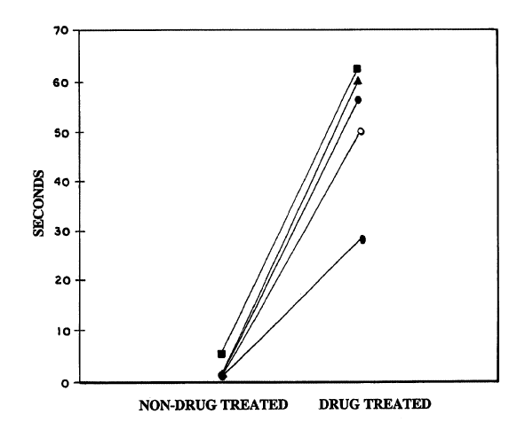
Pharmacological suppression and clinical results
Acetylcholinesterase Inhibitor
Beta-Adrenergic blockers
Calcium channel blockers

Slide 11
MATLAB SIMULATION

Slide 12
Working
Requires small stimulus current but AP generated is also small
Stimulus threshold - 500uA
2 neurons - large diameter
Inhibits if AP> V_threshold
Electrode 1
Pulse generator
S.A./A.V nodes inhibited
Flatline
Requires larger stimulus current and AP generated is large
Electrode 2
3 neurons - small diameter
Inhibits if AP> V_threshold
Stimulus threshold - 1mA

Slide 13
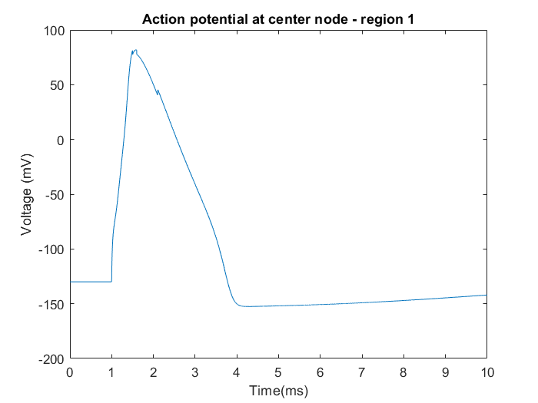
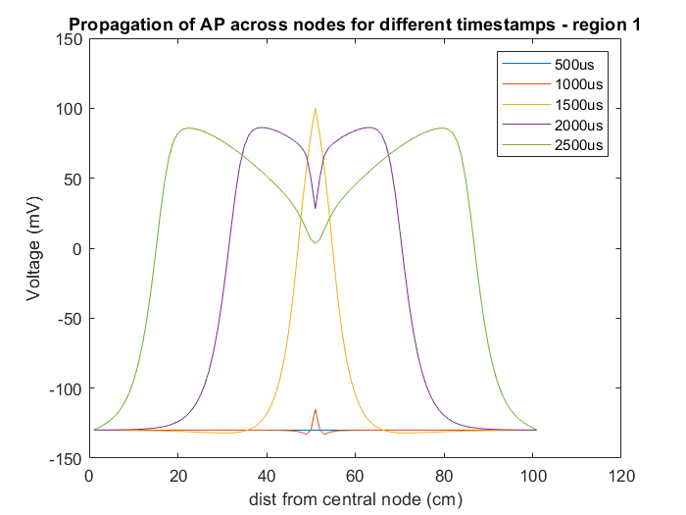
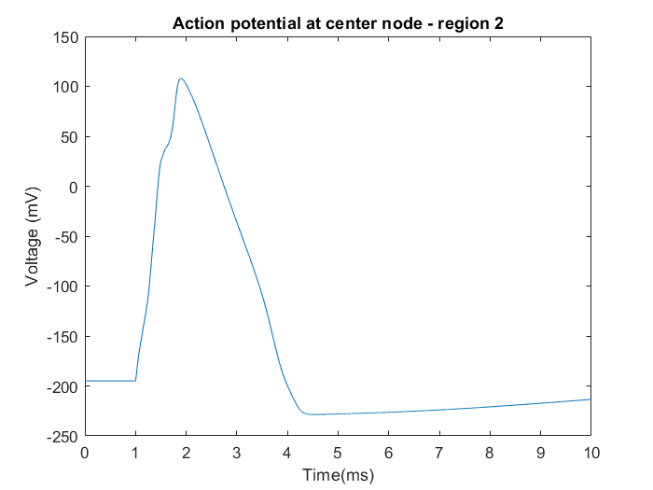
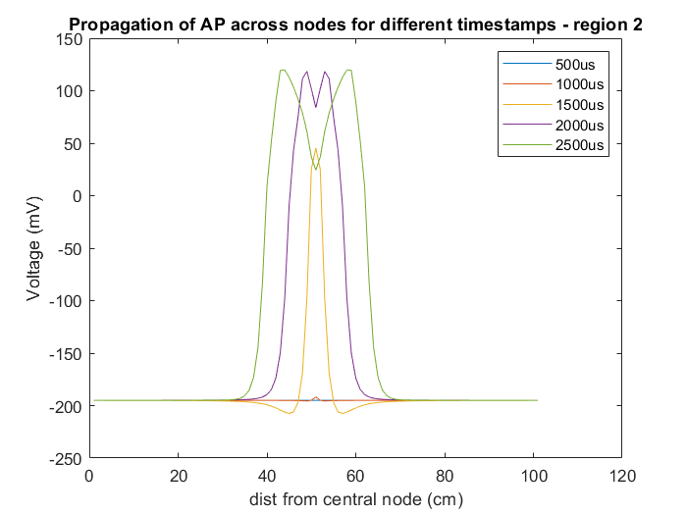
AP’s generated from both regions
Sum of APs’ from Region 1: 2 neurons
Sum of APs’ from Region 2:3 neurons

Slide 14
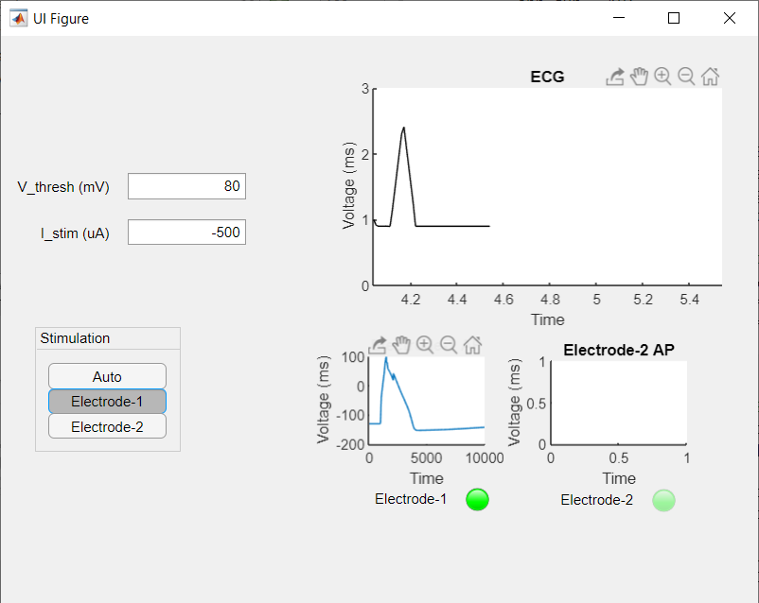
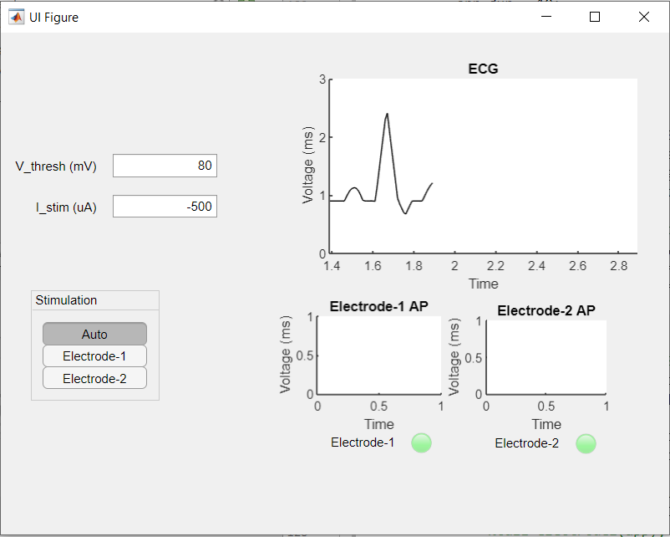
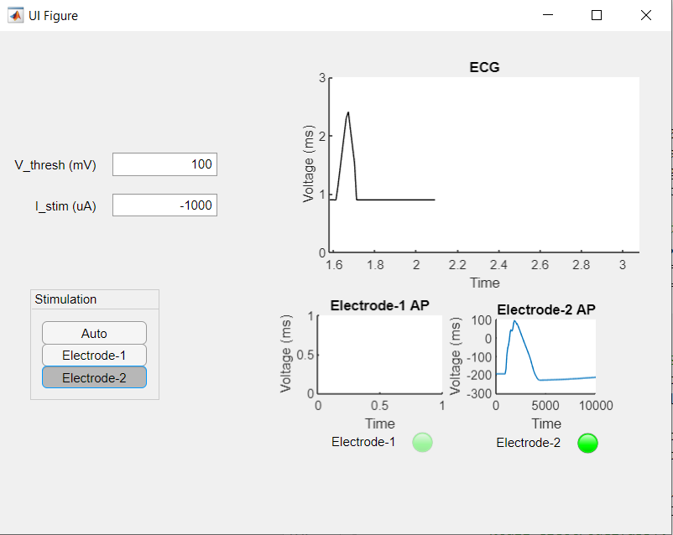
Application - screenshots
Flatline after stimulating from Electrode 1
Flatline after stimulating from Electrode 2
Normal ECG

Slide 15
Improvements required in simulation
The neuron stimulation in a region takes a very long time (1-2 minutes) the code needs to be optimised.
The Automatic mode which is the simulation of how the interrogator works is very slow due to lag in stimulation. In reality this is a very fast process.
The pulse generator used is inbuilt and the current is assumed to be constant which is not the case in reality where a controlled current source is required.

